Slide 1
Distributed objects and components

Slide 2
Introduction
Distributed object middleware
Component-based middleware

Slide 3
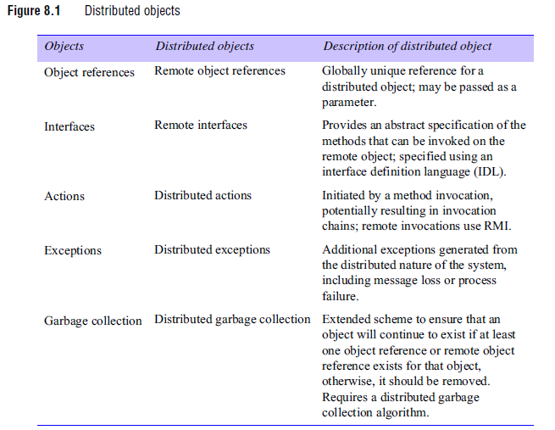
Distributed objects

Slide 4
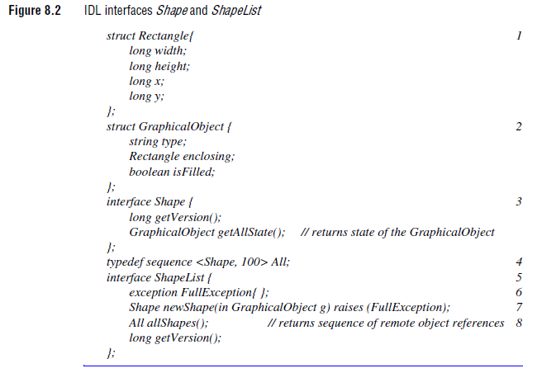
Case study : CORBA

Slide 5
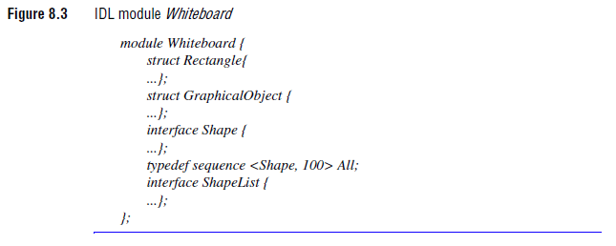
Case study : CORBA

Slide 6
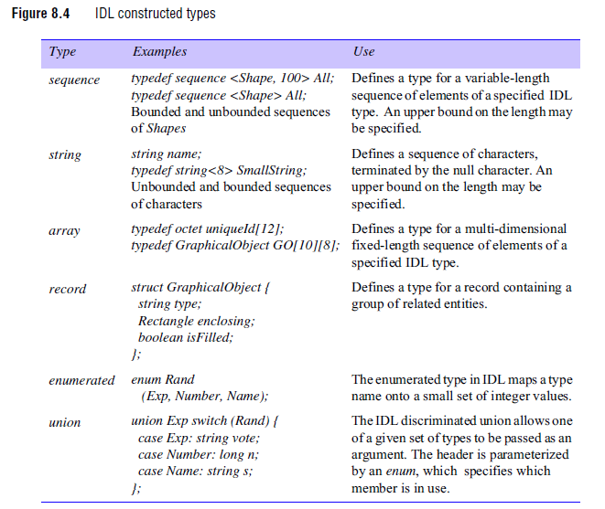
Case study : CORBA

Slide 7
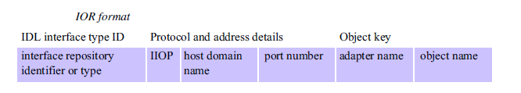
Case study : CORBA
CORBA remote object references

Slide 8
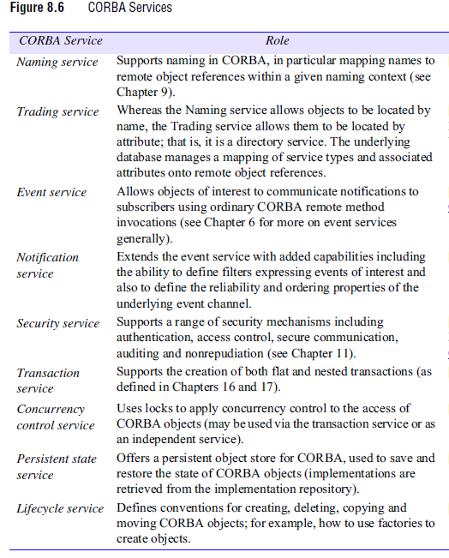
Case study : CORBA
CORBA services

Slide 9
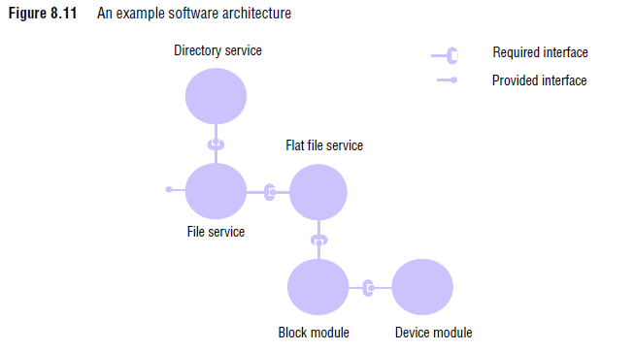
From object to components

