Slide 1
Operating System support

Slide 2
Operating System Layer
Figure 7.1 - System layers

Slide 3
Figure 7.2 Core OS functionality

Slide 4
Processes and threads
Figure 7.3 Address space

Slide 5
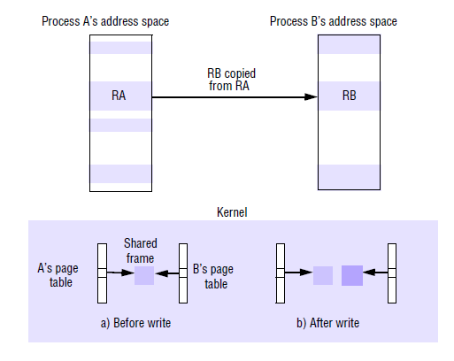
Processes and threads
Creation of new process
Creation of a new execution environment

Slide 6
Processes and threads
Threads ( self-study)

Slide 7
Communication and invocation
Figure 7.11
Invocations between address spaces

Slide 8
O.S. architecture
Monolithic
Microkernel

Slide 9
Figure 6.15
Monolithic kernel and microkernel

Slide 10
The role of the microkernel

