Slide 1
Remote Invocation
Pages 185 - 225

Slide 2
Objectives
Introduction
RRP
RPC
Remote method invocation(RMI)
Case study: java RMI

Slide 3
Introduction
Request-reply protocols
Remote procedure call model (RPC)
    allows client programs to call procedures in server programs running in separate processes and computers
Remote method invocation (RMI)
    allows an object living in one process to invoke methods of an object living in another process

Slide 4
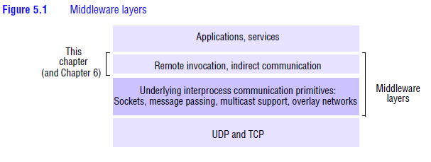
Introduction

Slide 5
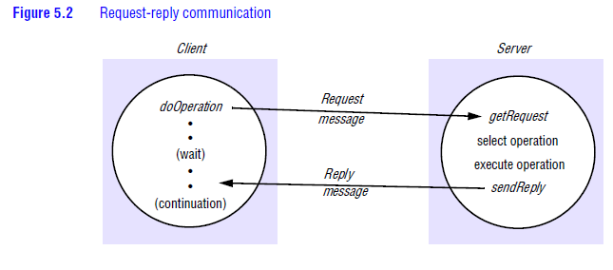
Request-reply protocols

Slide 6
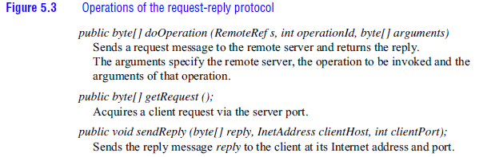
Request-reply protocols

Slide 7
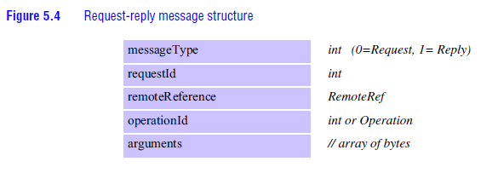
Request-reply protocols

Slide 8
Request-reply protocols
Message identifiers
Failure model
Timeout
Discarding duplicate request messages
Lost reply messages
History

Slide 9
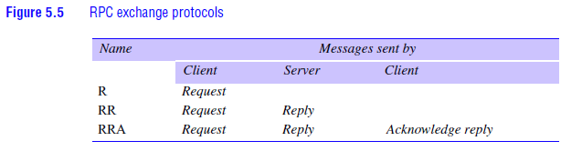
Request-reply protocols
Styles of exchange protocols

Slide 10
Request-reply protocols
HTTP
methods (get,head,post,put,delete,options,trace)

Slide 11
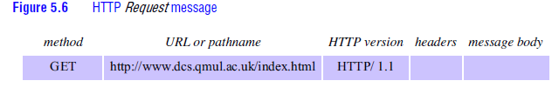
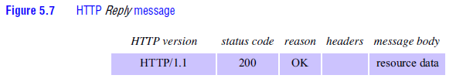
Request-reply protocols
Message contents (Request and reply message)

Slide 12
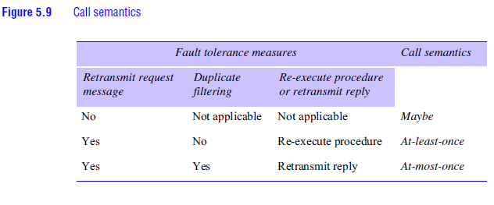
Remote procedure call
Design issues for RPC
RPC Call semantics

Slide 13
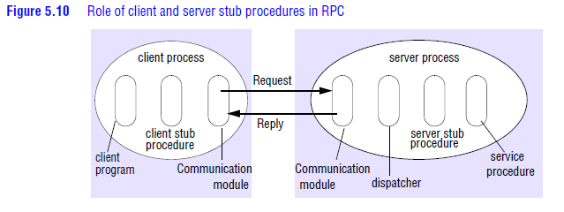
Remote procedure call
Implementation of RPC

Slide 14
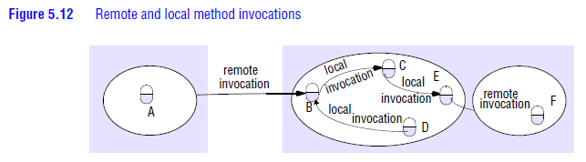
Remote method invocation
The object model
Distributed objects
The distributed object model

Slide 15
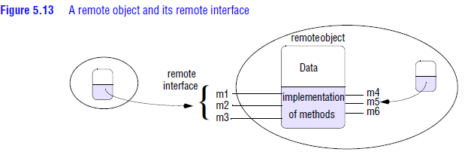
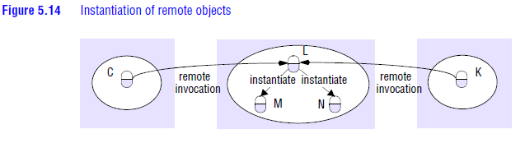
Remote method invocation

Slide 16
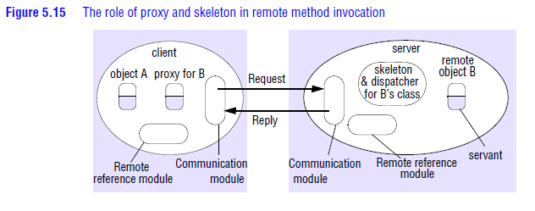
Remote method invocation
Implementation of RMI

Slide 17
Case Study : Java RMI
(self study)

