Slide 1
Chapter 4: Interprocess Communication‏
Pages 145 - 172

Slide 2
Objectives
Introduction.
The API for internet protocols
External Data representation and marshaling
Multicast communication.

Slide 3
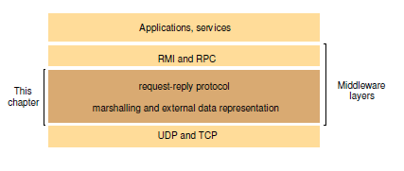
Middleware layers

Slide 4
API for Internet Protocols : characteristics of interprocess communication
synchronous and asynchronous communication
  blocking send: waits until the corresponding receive is issued
  non-blocking send: sends and moves on
  blocking receive: waits until the msg is received
  non-blocking receive: if the msg is not here, moves on
  synchronous: blocking send and receive
  asynchronous: non-blocking send and blocking or non-blocking receive

Slide 5
API for Internet Protocols : characteristics of interprocess communication
Message Destination
  IP address + port: one receiver, many senders
  Location transparency
    name server or binder: translate service to location
    OS (e.g. Mach): provides location-independent identifier mapping to lower-lever addresses
  send directly to processes (e.g. V System)
  multicast to a group of processes (e.g. Chorous)
Reliability
Ordering

Slide 6
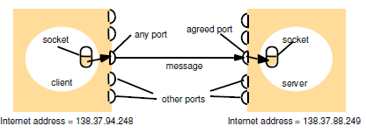
API for the Internet Protocols: Sockets and ports
programming abstraction for UDP/TCP
originated from BSD UNIX

Slide 7

API for Internet Protocols: UDP Datagram
message size: up to 2¹⁶, usually restrict to 8K
blocking: non-blocking send, blocking receive
timeouts: timeout on blocking receive
receive from any: doesn't specify sender origin (possible to specify a particular host for send and receive)
failure model:
  omission failures: can be dropped
  ordering: can be out of order
use of UDP
  DNS and less overhead: no state information, extra messages, latency due to start up

Slide 8
API for Internet Protocols : TCP stream
message size: unlimited
lost messages:
flow control
message duplication and ordering
message destination
matching of data items
blocking
Threads

Slide 9
API for Internet Protocols : TCP stream
failure model
  checksum to detect and reject corrupt packets
  sequence # to deal with lost and out-of-order packets
  connection broken if ack not received when timeout
  Use of TCP
  HTTP,FTP,Telnet,SMTP
  JAVA API for TCP streams: ServerSocket,Socket

Slide 10
External Data Representation and Marshalling
different ways to represent int, float, char... (internally)
byte ordering for integers
  big-endian: most significant byte first
  small-endian: least significant byte first
standard external data representation
  marshal before sending, unmarshal before receiving
send in sender's format and indicates what format, receivers translate if necessary
External data representation
  CORBA's Common Data Representation (CDR)
  Java's object serialization self study
  Extensible Markup Language (XML)

Slide 11
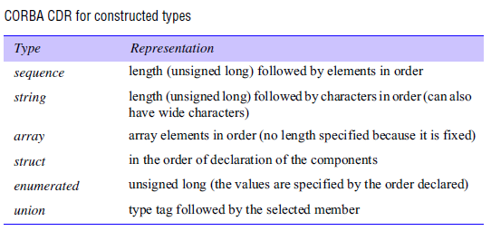
CORBA IDL

Slide 12
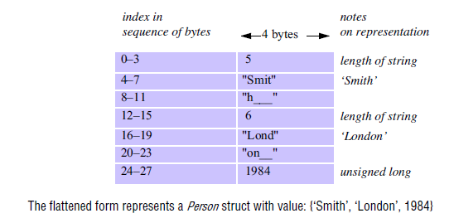
CORBA IDL compiler generates marshalling and unmarshalling routines
Struct. with string, string, unsigned long

Slide 13
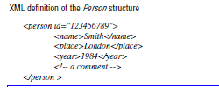
Extensible Markup Language (XML)

Slide 14
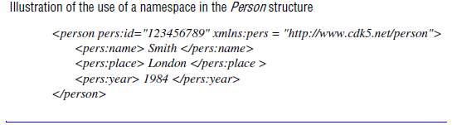
Extensible Markup Language (XML)
XML namespaces

Slide 15
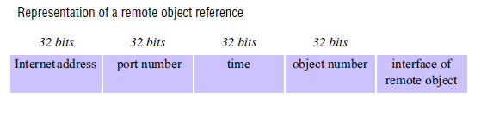
External Data Representation (2): Remote object reference
call methods on a remote object (CORBA, Java, ..)

Slide 16
Multicast communication
IP-multicast
Failure model for multicast datagrams

Slide 17
Multicast communication : IP multicast
Class D addresses, first four bits are 1110 in IPv4
multicast routers: route messages to out-going links that have members
multicast address allocation
  permanent
  temporary

