Slide 1
Chapter 3:
Networking and Internetworking

Slide 2
Introduction
Networking issues for distributed systems:
Performance,scalability,reliability,security ,mobility, quality of services, and multicasting.

Slide 3
Types of network
  Local area network (LAN): high speed, connection, segment, bandwidth, latency, cable, Ethernet.
  Wide area network (WAN): low speed, routing, source – destination, bandwidth.
  Metropolitan area network (MAN): high bandwidth, fiber optic.
  Wireless network

Slide 4
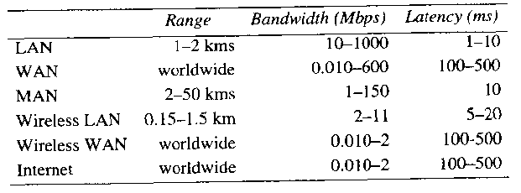
Models

Slide 5
Network principals
Packet transmission – message, packet, IP, buffer, delay, communication channel free.
Data stream: bandwidth, latency, reliability, establishing a channel.
Switching schemes
Protocols: rules and format.

Slide 6
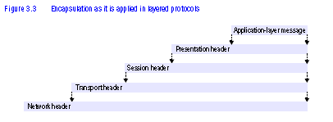
Protocol layers

Slide 7
Protocol Layers in OSI Protocol Model

Slide 8
OSI Protocol Summary
Layer
Description
Examples
Application
Protocols that are designed to meet the communication requirements of
HTTP,
FTP
,
SMTP,
specific applications, often defining the interface to a service.
CORBA IIOP
Presentation
Protocols at this level transmit data in a network representation that is
Secure Sockets
independent of the representations used in individual computers, which may
(
SSL),CORBA Data
differ. Encryption is also performed in this layer, if required.
Rep.
Session
At this level reliability and adaptation are performed, such as detection of
failures and automatic recovery.
Transport
This is the lowest level at which messages (rather than packets) are handled.
TCP,
UDP
Messages are addressed to communication ports attached to processes,
Protocols in this layer may be connection-oriented or connectionless.
Network
Transfers data packets between computers in a specific network. In a WAN
IP,
ATM virtual
or an internetwork this involves the generation of a route passing through
circuits
routers. In a single LAN no routing is required.
Data link
Responsible for transmission of packets between nodes that are directly
Ethernet MAC,
connected by a physical link. In a WAN transmission is between pairs of
ATM cell transfer,
routers or between routers and hosts. In a LAN it is between any pair of hosts.
PPP
Physical
The circuits and hardware that drive the network. It transmits sequences of
Ethernet base- band
binary data by analogue signalling, using amplitude or frequency modulation
signalling,
ISDN
of electrical signals (on cable circuits), light signals (on fibre optic circuits)
or other electromagnetic signals (on radio and microwave circuits).

Slide 9
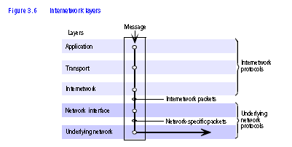
Internetwork layers

Slide 10
Internetwork layers
Protocol suites
Packet assembly
Addressing
Packet delivery

Slide 11
Routing
Routing is a function that is required in all networks excepts that LANs such as Ethernet that provide the direct connection between all pairs of attached hosts.
In the large networks adaptive routing which is the best route for communication between two points and this route is identifies by periodically re-evaluation, is employed.
Assume a packet switching network shown in the next slide, the routers located at connection points are responsible for delivery of packets.

Slide 12
Routing
A
1
B
Hosts
2
3
Links
4
or local
C
networks
5
D
6
E
Routers

Slide 13
Routing
A simple algorithm for routing discussed here is “distance vector” algorithm which is the basis for link-state algorithm that is used by Internet.
In this algorithm each router has a table contains a single entry for each possible destination showing the next hope (link field in the table) that packet must take toward its destination.
Cost field in the table is simple calculation of vector distance or number of hopes for a given destination. See the next slide that shows routing tables for the previous network.

Slide 14
Routing
Routings from A
Routings from B
Routings from C
To
Link
Cost
To
Link
Cost
To
Link
Cost
A
local
0
A
1
1
A
2
2
B
1
1
B
local
0
B
2
1
C
1
2
C
2
1
C
local
0
D
3
1
D
1
2
D
5
2
E
1
2
E
4
1
E
5
1
Routings from D
Routings from E
To
Link
Cost
To
Link
Cost
A
3
1
A
4
2
B
3
2
B
4
1
C
6
2
C
5
1
D
local
0
D
6
1
E
6
1
E
local
0

Slide 15
Routing
For a packet addressed to C, when it arrives at the router at A, the algorithm uses routing table in A and choose the row staring with C therefore forwards the packet to link labeled 1.
When the packet arrives at B same procedure is followed and link 2 will be selected
When packet arrives at C, routing table entry shows local that means packet should be delivered to a local host
The routing tables will be built up and maintained whenever faults occur in the network

Slide 16
Internetworking: Simplified View of the QMW Computer Science Network (2000)
Campus
138.37.95.240/29
138.37.95.241
router/
subnet
firewall
router
hammer
Staff subnet
Student subnet
138.37.88
138.37.88.251
138.37.94.251
138.37.94
compute
Eswitch
Eswitch
file server/
server
gateway
bruno
138.37.88.249
custard
printers
dialup
138.37.94.246

server
henry
138.37.88.230
other
file
servers
server
hotpoint
138.37.88.162
web
server
copper
138.37.88.248
hub
hub
desktop computers
138.37.88.xx
desktop computers
138.37.94.xx
Campus
138.37.95.248/29
sickle
100 Mbps Ethernet
router
subnet
138.37.95.249
router/
firewall
1000 Mbps Ethernet
Eswitch: Ethernet switch

Slide 17
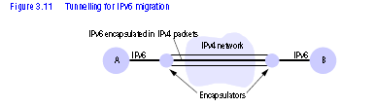
Internetwork
Routers
Bridges
Hubs
Switches
Tunneling

Slide 18
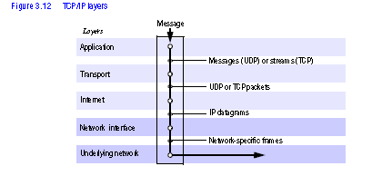
Internet protocols

Slide 19
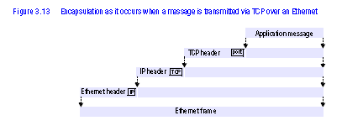
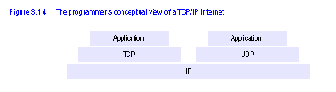

Slide 20
Internetworking / Internet Address Structure
Switches: Performs similar function as routers but for local networks (usually Ethernet) only.
Hubs: used for connecting hosts and extension

Slide 21
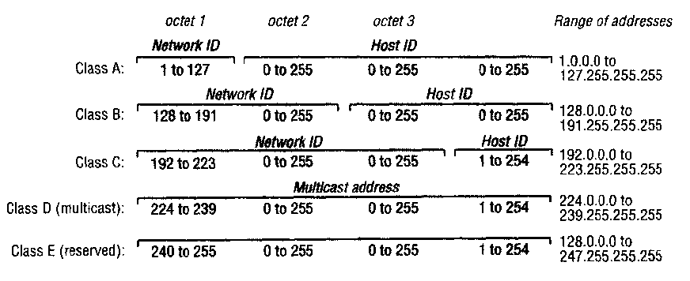

Slide 22

IP addressing and The IP protocol

